Slide 1
形式语言与自动机理论 S4 图灵机与可计算性
李钦 副教授
华东师范大学
软件工程学院

Slide 2
图灵机
Turing machine
Finite control: an Infinite tape and a tape head
The input is placed on the tape
The other cells are initially blank
Turing machine write a symbol in the cell scanned and move the tape head left or right

Slide 3

Turing machine
A Turing machine is a 7-tuple $(Q,Σ,Γ,δ,q_{0},B,F)$
$Q$ is a finite set of states of the finite control
$Σ$ is a finite set of input symbols
$Γ$ is a set of tape symbols, $Σ⊂Γ$
$δ:Q×Γ→Q×Γ×\{L,R\}$ is a transition function
$q_{0}∈Q$ is a start state
$B∈Γ−Σ$ is blank symbol
$F⊆Q$ is a set of final (accept) states

Slide 4

Transition of TM
Given a state $q$ and a tape symbol $X$,
$δ\left(q,X\right)=(p,Y,D)$ where
$p$ is the next state
$Y$ is the tape symbol replacing the symbol at the current cell
$D$ is a direction ($L$ or $R$) to move the tape head to the next cell
$δ(q,X)$ can be undefined
TM halts when no transition from that state is possible

Slide 5
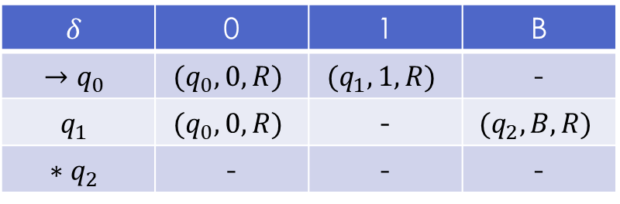

Example
$M=(\left\{q_{0},q_{1},q_{2}\right\},\left\{0,1\right\},\left\{0,1,B\right\},δ,q_{0},B,\left\{q_{2}\right\})$
$δ\left(q_{0},0\right)=\left(q_{0},0,R\right)$
$δ\left(q_{0},1\right)=\left(q_{1},1,R\right)$
$δ\left(q_{1},0\right)=\left(q_{0},0,R\right)$
$δ\left(q_{1},B\right)=(q_{2},B,R)$
The transition function can be represented as a table
$$δ$$ | 0 | 1 | B
$$→q_{0}$$ | $$(q_{0},0,R)$$ | $$(q_{1},1,R)$$ | -
$$q_{1}$$ | $$(q_{0},0,R)$$ | - | $$(q_{2},B,R)$$
$$∗q_{2}$$ | - | - | -

Slide 6

瞬时描述
An ID of TM is a string $X_{1}X_{2}…X_{i−1}qX_{i}X_{i+1}…X_{n}$
$q$ is the current state
The tape head is scanning the ith symbol
$X_{1}…X_{n}$ is the entries of tape between the leftmost and rightmost blank
A move of TM is a relation $⊢$
If $δ\left(q,X_{i}\right)=(p,Y,L)$, then
$X_{1}…X_{i−1}qX_{i}…X_{n}⊢X_{1}…X_{i−2}pX_{i−1}YX_{i+1}…X_{n}$
if $i=1$, then $qX_{1}X_{2}…X_{n}⊢pBYX_{2}…X_{n}$
if $i=n$ and $Y=B$, then $X_{1}…X_{n−1}qX_{n}⊢X_{1}…X_{n−2}pX_{n−1}$
If $δ\left(q,X_{i}\right)=(p,Y,R)$, then
$X_{1}…X_{i−1}qX_{i}…X_{n}⊢X_{1}…X_{i−2}X_{i−1}YpX_{i+1}…X_{n}$
if $i=n$, then $X_{1}…X_{n−1}qX_{n}⊢X_{1}…X_{n−1}YpB$
if $i=1$ and $Y=B$, then $qX_{1}X_{2}…X_{n}⊢pX_{2}…X_{n}$

Slide 7
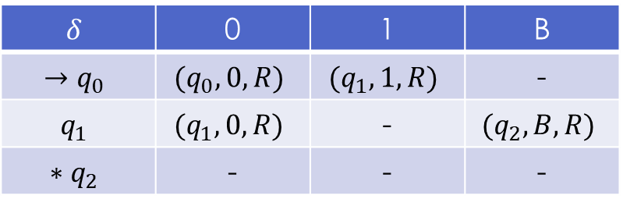

Example
The acceptance of string 00100 by $M$
$q_{0}00100⊢0q_{0}0100⊢00q_{0}100⊢001q_{1}00$ $⊢0010q_{1}0⊢00100q_{1}B⊢00100Bq_{2}B$ accept
The rejection of string 00000 by $M$
$q_{0}00000⊢0q_{0}0000⊢00q_{0}000⊢000q_{0}00$ $⊢0000q_{0}0⊢00000q_{0}B$ reject
$$δ$$ | 0 | 1 | B
$$→q_{0}$$ | $$(q_{0},0,R)$$ | $$(q_{1},1,R)$$ | -
$$q_{1}$$ | $$(q_{1},0,R)$$ | - | $$(q_{2},B,R)$$
$$∗q_{2}$$ | - | - | -

Slide 8
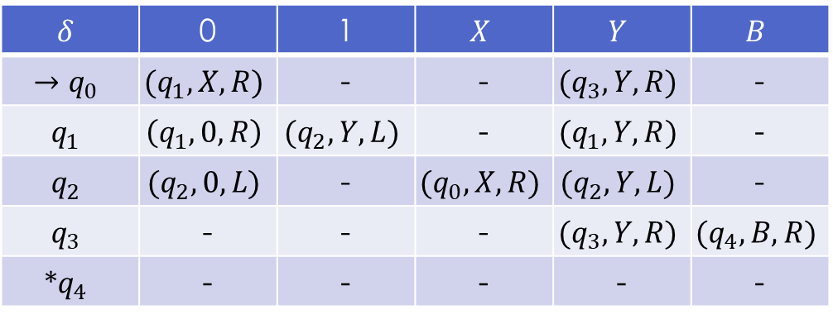

Example
Design a TM accepting the language $\left\{0^{n}1^{n} \right| n≥1\}$
$M=\left(\left\{q_{0},q_{1},q_{2},q_{3},q_{4}\right\},\left\{0,1\right\},\left\{0,1,X,Y,B\right\},δ,q_{0},B,\left\{q_{4}\right\}\right)$
$δ$ is shown by the following table
$$δ$$ | 0 | 1 | $$X$$ | $$Y$$ | $$B$$
$$→q_{0}$$ | $$(q_{1},X,R)$$ | - | - | $$(q_{3},Y,R)$$ | -
$$q_{1}$$ | $$\left(q_{1},0,R\right)$$ | $$(q_{2},Y,L)$$ | - | $$(q_{1},Y,R)$$ | -
$$q_{2}$$ | $$(q_{2},0,L)$$ | - | $$(q_{0},X,R)$$ | $$(q_{2},Y,L)$$ | -
$$q_{3}$$ | - | - | - | $$(q_{3},Y,R)$$ | $$(q_{4},B,R)$$
$$∗q_{4}$$ | - | - | - | - | -

Slide 9

Example
we can also represent the TM with diagram
the acceptance of string 0011
$q_{0}0011⊢Xq_{1}011⊢X0q_{1}11⊢Xq_{2}0Y1⊢q_{2}X0Y1⊢Xq_{0}0Y1$ $⊢XXq_{1}Y1⊢XXYq_{1}1⊢XXq_{2}YY⊢Xq_{2}XYY⊢XXq_{0}YY$ $⊢XXYq_{3}Y⊢XXYYq_{3}B⊢XXYYBq_{4}B$ accept

Slide 10

Language of a TM
Let $M=(Q,Σ,Γ,δ,q_{0},B,F)$ be a TM.
$L\left(M\right)=\left\{w \right| w∈Σ^{∗}∧ q_{0}w⊢^{∗}αpβ∧ p∈F ∧ α,β∈Γ^{∗}\}$
The language of a TM is called Recursively Enumerable Language
A TM can accept any string that can reach its final state even if the string is not all scanned.

Slide 11
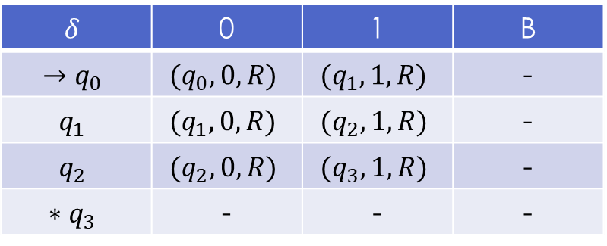

Example
Guess what language is $L\left(M\right)$
$L\left(M\right)=\left\{w \right| w∈{\left\{0,1\right\}}^{∗}∧\left|1\right|≥3\}$
$q_{0}1001100100⊢^{∗}10011q_{3}00100$ accept
$$δ$$ | 0 | 1 | B
$$→q_{0}$$ | $$(q_{0},0,R)$$ | $$(q_{1},1,R)$$ | -
$$q_{1}$$ | $$(q_{1},0,R)$$ | $$(q_{2},1,R)$$ | -
$$q_{2}$$ | $$(q_{2},0,R)$$ | $$(q_{3},1,R)$$ | -
$$∗q_{3}$$ | - | - | -

Slide 12
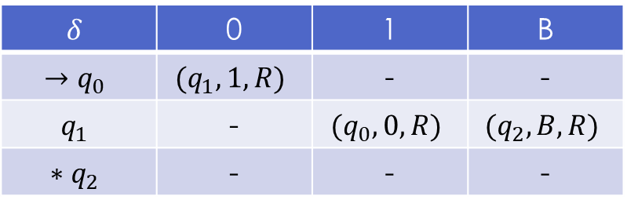




Exercise
Guess what language is $L(M)$
$$δ$$ | 0 | 1 | B
$$→q_{0}$$ | $$(q_{1},1,R)$$ | - | -
$$q_{1}$$ | - | $$(q_{0},0,R)$$ | $$(q_{2},B,R)$$
$$∗q_{2}$$ | - | - | -
$${\left(01\right)}^{∗}0$$
$$δ$$ | 0 | 1 | B
$$→q_{0}$$ | $$(q_{1},1,R)$$ | - | -
$$q_{1}$$ | - | $$(q_{2},0,L)$$ | $$(q_{3},B,R)$$
$$q_{2}$$ | - | $$(q_{0},1,R)$$ | -
$$∗q_{3}$$ | - | - | -
$$01^{∗}$$

Slide 13

TM as a computer of functions
TM can be used to compute integer-valued functions
A nonnegative integer $n$ can be represented by string $0^{n}$
For an integer-valued function $f(n_{1},n_{2},…,n_{k})$, we represent it by string $0^{n_{1}}{10}^{n_{2}}1…{10}^{n_{k}}$
The TM will start with a tape having $0^{n_{1}}{10}^{n_{2}}1…{10}^{n_{k}}$ surrounded by blanks
The TM will halts with $0^{m}$ on the tape if the result of $f$ is $m$
A function is called Turing computable if there is a TM which can compute it

Slide 14
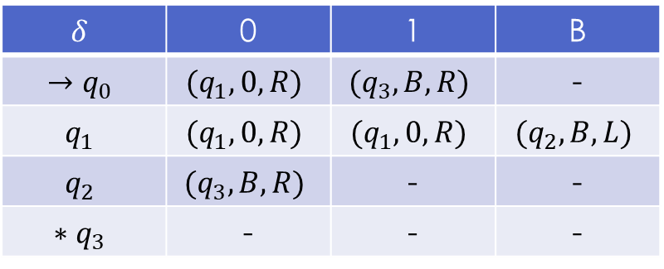

Example
The arithmetic operation such as $+, −, ×$ are all Turing computable
Design a TM $M$ to compute $n+m$ for any nonnegative integers $n$ and $m$
input: $0^{n}{10}^{m}$
output: $0^{n+m}$ when $M$ halts
$M=(\left\{q_{0},q_{1},q_{2},q_{3}\right\},\left\{0,1\right\},\left\{0,1,B\right\},δ,q_{0},B,\{q_{3}\})$
$$δ$$ | 0 | 1 | B
$$→q_{0}$$ | $$(q_{1},0,R)$$ | $$(q_{3},B,R)$$ | -
$$q_{1}$$ | $$(q_{1},0,R)$$ | $$(q_{1},0,R)$$ | $$(q_{2},B,L)$$
$$q_{2}$$ | $$(q_{3},B,R)$$ | - | -
$$∗q_{3}$$ | - | - | -

Slide 15

Example
Compute 3+2
$q_{0}000100⊢0q_{1}00100⊢00q_{1}0100⊢000q_{1}100$ $⊢0000q_{1}00⊢00000q_{1}0⊢000000q_{1}B$ $⊢00000q_{2}0B⊢00000Bq_{3}B$ accept

Slide 16

Example
Design a TM to compute $m∸n≜max⁡(m−n,0)$ for any nonnegative integers $m$ and $n$
input: $0^{m}{10}^{n}$
output: $0^{m∸n}$

Slide 17
Example
Solution:
Read the first symbol,
If it is 1, then remove all symbols and accept with result 0
If it is 0, then replace it with B and move right
Read rightwards until the end of the first integer
Read and replace the symbol of the second integer with 1and move leftwards
Repeat the above until either
The first integer becomes all B or
The second integer becomes all 1
For case 1, removes all symbols and accept with result 0
For case 2, replace the last B of the first integer with 0 and remove all 1 to the right to B and accept

Slide 18
Example

Slide 19
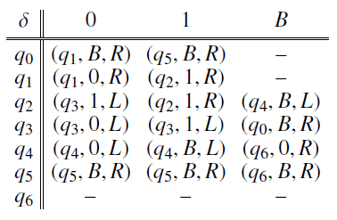
Example

Slide 20

Example
Compute $3∸2$
$q_{0}000100⊢Bq_{1}00100⊢B0q_{1}0100⊢B00q_{1}100⊢B001q_{2}00$ $⊢B00q_{3}110⊢B0q_{3}0110⊢Bq_{3}00110⊢q_{3}B00110$ $⊢Bq_{0}00110⊢BBq_{1}0110⊢BB0q_{1}110⊢BB01q_{2}10$ $⊢BB011q_{2}0⊢BB01q_{3}11⊢BB0q_{3}111⊢BBq_{3}0111$ $⊢Bq_{3}B0111$ $⊢BBq_{0}0111⊢BBBq_{1}111⊢BBB1q_{2}11⊢BBB11q_{2}1$ $⊢BBB111q_{2}B⊢BBB11q_{4}1B⊢BBB1q_{4}1BB⊢BBBq_{4}1BBB$ $⊢BBq_{4}BBBBB$ $⊢BB0q_{6}BBBB$ accept

Slide 21

课后作业
write down the process of the TM computing $5∸3$ and $3∸5$
Design a Turing machine accepting the language $L=\left\{a^{i}b^{j}c^{k} \right| i,j,k≥1, i=j+k\}$

Slide 22
Turing machine structures
State as storage
The finite control can represent not only the position of the TM but also holding a finite amount of data

Slide 23

Example
Design a TM accepting the language $({01}^{∗}+{10}^{∗})$
Let $Q$ be the form of $\left\{p,q\right\}×\{0,1,B\}$
Control portion: $q$ means M has not yet read its first symbol. $p$ means M has read the symbol
Data portion: recording the first symbol seen (0 or 1). The symbol B means no symbol has been read
$Q=\{q\left[B\right],p\left[0\right],p\left[1\right],p[B]\}$, $q[B]$ is the start state, $p[B]$ is the final state
$\text{F}\text{or} a∈\{0,1\}$
$δ\left(q\left[B\right],a\right)=(p\left[a\right],a,R)$
$δ\left(p\left[a\right],1−a\right)=(p\left[a\right],1−a,R)$
$δ\left(p\left[a\right],B\right)=(p\left[B\right],B,R)$

Slide 24

Example
Design a TM adding string 101 as suffix of its input string
$Q=\left\{q\left[101\right],q\left[01\right],q\left[1\right],q\left[ε\right]\right\}$
$q[101]$ is the start state
$q\left[ε\right]$ is the final state
Design $δ$
$δ\left(q\left[101\right],a\right)=(q\left[101\right],a,R)$ for $a∈\{0,1\}$
$δ\left(q\left[101\right],B\right)=(q\left[01\right],1,R)$
$δ\left(q\left[01\right],B\right)=(q\left[1\right],0,R)$
$δ\left(q\left[1\right],B\right)=(q\left[ε\right],1,R)$

Slide 25
Multiple tracks
A Turing machine with its tape having multiple tracks
Treat one track as holding data and another track as holding marks

Slide 26

Example
Design a TM recognizing the language $L_{wcw}=\left\{wcw \right| w∈{\left\{0,1\right\}}^{+}\}$
$M=(Q,\{0,1,c\},Γ,δ,q_{1}\left[B\right], \left[B,B\right], \left\{q_{9}\left[B\right]\right\})$
$Q=\left\{q_{1},…,q_{9}\right\}×\{0,1,B\}$
$Γ=\left\{B,∗\right\}×\{0,1,c,B\}$ where $B$ is blank and $∗$ is a mark
For $a,b∈\{0,1\}$ and $a≠b$
$δ\left(q_{1}\left[B\right],\left[B,a\right]\right)=(q_{2}\left[a\right],\left[∗,a\right],R)$ read first symbol $a$
$δ\left(q_{2}\left[a\right],\left[B,b\right]\right)=(q_{2}\left[a\right],\left[B,b\right],R)$ move right, looking for $c$
$δ\left(q_{2}\left[a\right],\left[B,c\right]\right)=(q_{3}\left[a\right],\left[B,c\right],R)$ find $c$, change to $q_{3}$
$δ\left(q_{3}\left[a\right],\left[∗,b\right]\right)=(q_{4}\left[B\right],\left[∗,b\right],R)$ move right, past all checked symbol

Slide 27

Example
$δ\left(q_{3}\left[a\right],\left[B,a\right]\right)=(q_{4}\left[B\right],\left[∗,a\right],L)$ find the first matched symbol, go to $q_{4}$ and move left
$δ\left(q_{4}\left[B\right],\left[∗,b\right]\right)=(q_{4}\left[B\right],\left[∗,b\right],L)$ move left, past all checked symbols
$δ\left(q_{4}\left[B\right],\left[B,c\right]\right)=(q_{5}\left[B\right],\left[B,c\right],L)$ encounter $c$, go to $q_{5}$
The symbol to the left of $c$ is unchecked
$δ\left(q_{5}\left[B\right],\left[B,a\right]\right)=(q_{6}\left[B\right],\left[B,a\right],L)$ go to $q_{6}$
$δ\left(q_{6}\left[B\right],\left[B,b\right]\right)=(q_{6}\left[B\right],\left[B,b\right],L)$ continue moving left, looking for a checked symbol
$δ\left(q_{6}\left[B\right],\left[∗,a\right]\right)=(q_{1}\left[B\right],\left[∗,a\right],R)$ find the checked symbol, return to $q_{1}$ and repeat a new search.

Slide 28

Example
The symbol to the left of $c$ is checked
$δ\left(q_{5}\left[B\right],\left[∗,a\right]\right)=(q_{7}\left[B\right],\left[∗,a\right],R)$ go to $q_{7}$, move right again
$δ\left(q_{7}\left[B\right],\left[B,c\right]\right)=(q_{8}\left[B\right],\left[B,c\right],R)$ move across symbol $c$ and continue moving right
$δ\left(q_{8}\left[B\right],\left[∗,a\right]\right)=(q_{8}\left[B\right],\left[∗,a\right],R)$ move right past all checked symbols
$δ\left(q_{8}\left[B\right],\left[B,B\right]\right)=(q_{9}\left[B\right],\left[B,B\right],R)$ enter accepting state $q_{9}$ if reach a blank without encountering unchecked symbols

Slide 29






Example
B | B | B | B | B | B
0 | 1 | c | 0 | 1 | B
* | B | B | B | B | B
0 | 1 | c | 0 | 1 | B
$$q_{1}[B]$$
$$q_{2}[0]$$
* | B | B | B | B | B
0 | 1 | c | 0 | 1 | B
* | B | B | B | B | B
0 | 1 | c | 0 | 1 | B
$$q_{2}[0]$$
$$q_{3}[0]$$
* | B | B | * | B | B
0 | 1 | c | 0 | 1 | B
* | B | B | * | B | B
0 | 1 | c | 0 | 1 | B
$$q_{4}[B]$$
$$q_{5}[B]$$

Slide 30






Example
* | B | B | * | B | B
0 | 1 | c | 0 | 1 | B
* | B | B | * | B | B
0 | 1 | c | 0 | 1 | B
$$q_{6}[B]$$
$$q_{1}[B]$$
* | * | B | * | B | B
0 | 1 | c | 0 | 1 | B
* | * | B | * | B | B
0 | 1 | c | 0 | 1 | B
$$q_{2}[1]$$
$$q_{3}[1]$$
* | * | B | * | B | B
0 | 1 | c | 0 | 1 | B
* | * | B | * | * | B
0 | 1 | c | 0 | 1 | B
$$q_{3}[1]$$
$$q_{4}[B]$$

Slide 31






Example
* | * | B | * | * | B
0 | 1 | c | 0 | 1 | B
* | * | B | * | * | B
0 | 1 | c | 0 | 1 | B
$$q_{4}[B]$$
$$q_{5}[B]$$
* | * | B | * | * | B
0 | 1 | c | 0 | 1 | B
* | * | B | * | * | B
0 | 1 | c | 0 | 1 | B
$$q_{7}[B]$$
$$q_{8}[B]$$
* | * | B | * | * | B
0 | 1 | c | 0 | 1 | B
* | * | B | * | * | B
0 | 1 | c | 0 | 1 | B
$$q_{8}[B]$$
$$q_{9}[B]$$

Slide 32

Subroutine
Design a TM to compute $m∗n$ for any nonnegative integers $m$ and $n$
input: $0^{m}{10}^{n}$
output: $0^{mn}$
Solution:
change a 0 of the first group to B
add $n$ 0s to the end of the string
return to the head of the string and process remaining 0s of the first group
repeat until the first group is completely changed to blanks
change the original ${10}^{n}$ to blanks and done

Slide 33
Subroutine
Construct a subroutine Copy which implement step 2

Slide 34
Subroutine
Embed the subroutine Copy to complete the TM

Slide 35
图灵机的扩展及变型
Multi-tape Turing machine
Non-deterministic Turing machine

Slide 36
Multi-tape TM
A multi-tape TM has a finite control and finite number of tapes.
Initially, the input is placed on the first tape. The head of the first tape is at the head of the input. The head of other tapes are at arbitrary cell.
The head of each tape moves independently

Slide 37

Theorem
If $M_{m}$ is a multi-tape TM, then there is a one-tape TM $M_{1}$ such that $L\left(M_{m}\right)=L(M_{1})$

Slide 38

Non-deterministic TM
A non-deterministic TM has a transition function $δ$ such that for each state $q$ and tape symbol $X$, $δ(q,X)$ is a set of triples $\{\left(q_{1},Y_{1},D_{1}\right),…\left(q_{k},Y_{k},D_{k}\right)\}$
NTM accepts an string $w$ if there is any sequence from initial input $w$ that leads to the final state
Theorem: If $M_{N}$ is a NTM, then there is a DTM $M_{D}$ such that $L\left(M_{N}\right)=L(M_{D})$

Slide 39
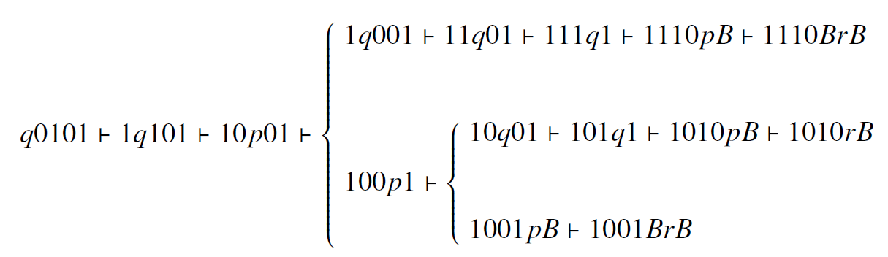
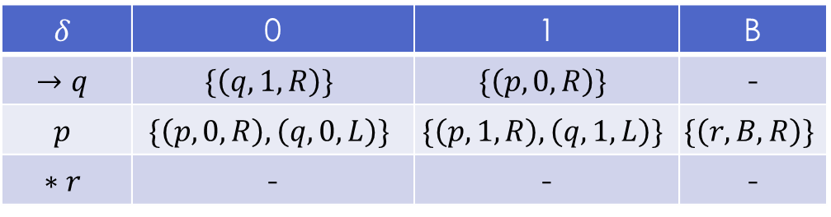

Example
Let NTM $M=\left(\left\{q,p,r\right\},\left\{0,1\right\},\left\{0,1,B\right\},δ,q,B,\left\{r\right\}\right)$
The process that accepts string 0101
$$δ$$ | 0 | 1 | B
$$→q$$ | $$\{\left(q,1,R\right)\}$$ | $$\{\left(p,0,R\right)\}$$ | -
$$p$$ | $$\{\left(p,0,R\right),\left(q,0,L\right)\}$$ | $$\{\left(p,1,R\right),\left(q,1,L\right)\}$$ | $$\{\left(r,B,R\right)\}$$
$$∗r$$ | - | - | -

Slide 40

课后作业
设计一个多带图灵机，计算两个正整数$a,b$的最大公约数
提示：采用辗转相减法
如果a=b，则最大公约数即为a或者b
如果a≠b，则将a, b两数相减，将差值存入被减数，减数不变
重复执行步骤2，直到a, b两数相等为止，此时最大公约数即为a或者b

Slide 41

图灵机和0型文法的等价性
$L$ can be generated by $G=(V,T,P,S)$, iff $L$ can be recognized by a Turing machine
Proof: $(⇒)$
Construct a TM $M$ with two tapes. One tape is for the input $w∈L(G)$, the other tape is for the derivation of $w$ through $P$.
Initially, put input string $w$ on tape 1 and start symbol $S$ on tape 2.
Apply a production rule $α→β∈P$ by replacing $α$ on tape 2 by $β$
Compare the 2 tapes.
If the string on tape 2 is equal to $w$, accept
If not, repeat applying production rules to nonterminal symbols

Slide 42

图灵机和0型文法的等价性
Proof: $(⇐)$
Let $M=(Q,Σ,Γ,δ,q_{0},F)$, construct a grammar $G$ where
$V=Q∪\left(Σ^{ε}×Γ\right)∪\{S_{1},S_{2},S_{3}\}$
$S_{1}→q_{0}S_{2}$
$S_{2}→\left(a,a\right)S_{2}$ for every $a∈Σ$
$S_{2}→S_{3}$
$S_{3}→\left(ε,ε\right)S_{3} | ε$
$q\left(a,X\right)→\left(a,Y\right)p$ if $δ\left(q,X\right)=(p,Y,R)$
$\left(a,X\right)q→p(a,Y)$ if $δ\left(q,X\right)=(p,Y,L)$
$\left(a,X\right)q→qaq$, $q\left(a,X\right)→qaq$, $q→ε$ for $q∈F$

Slide 43

Recursive Enumerable Language
A language is RE iff it can be accepted by a TM
A RE $L$ can be classified into two classes
Recursive:
If $w∈L$, then $M$ halts on the accepting state
If $w∉L$, then $M$ halts on an non-accepting state
Non-Recursive:
If $w∈L$, then $M$ halts on the accepting state
If $w∉L$, then $M$ may run forever and never halts

Slide 44

Decidability
If we think of the language $L$ as a problem
Then problem $L$ is called decidable iff it is a recursive language
An algorithm for a problem is a well-defined sequence of steps that always finishes and produces an answer

Slide 45
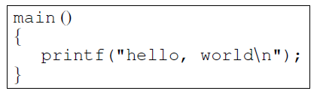
Problems that computer cannot solve
Hello-world Problem
Determine whether a given C program, with a given input, prints hello, world as its first output

Slide 46
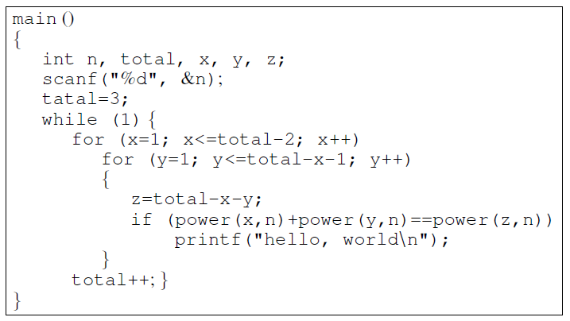
Example

Slide 47

Example
The above program searches every triple of positive integers $x,y,z$ and tests if $x^{n}+y^{n}=z^{n}$ for input $n$. If so, the program prints hello, world.
According to Fermat’s Last Theorem
If $n>2$, there are no integer solutions to the equation $x^{n}+y^{n}=z^{n}$
The program will never terminate and print hello, world

Slide 48
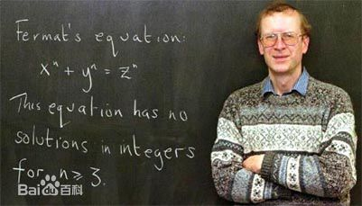
Example
However, it takes the mathematicians 300 years to finally prove the Fermat’s Last Theorem. (by Andrew Wiles in 1993)
Until then, we cannot determine if the program can eventually terminate or not

Slide 49
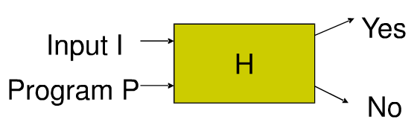
The hello-world problem is undecidable
Proof:
Assume that we have an algorithm H that can solve this problem with any given input I and program P
H prints Yes when P prints “hello world” with input I
H prints No when P does not print hello-world with input I

Slide 50
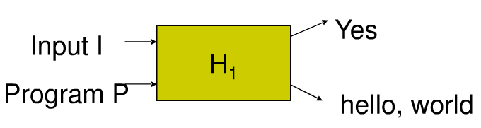

Proof
Build $H_{1}$ from $H$ such that $H_{1}$ prints hello world when $H$ returns no, that is, when the given program $P$ does not print hello world with the given input $I$
$H_{1}\left(I,P\right)=H\left(I,P\right)$ if $H\left(I,P\right)=Yes$
$H_{1}\left(I,P\right)=hello, world$ if $H\left(I,P\right)=No$

Slide 51


Proof
Build $H_{2}$ from $H_{1}$ such that $H_{2}$ takes program P as both input I and P
$H_{2}\left(P\right)=H_{1}(P,P)$

Slide 52
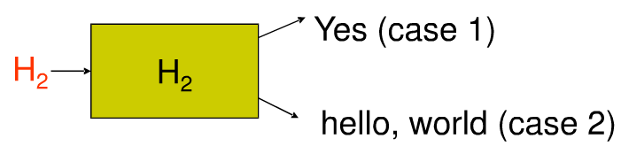

Proof
Now we consider the situation that the input $P=H_{2}$
We hope to get a contradiction so that to prove $H_{2}$ cannot exist and so does $H_{1}$ and $H$

Slide 53

Proof
Case 1: $H_{2}$ prints Yes (not hello world) with input $H_{2}$
$H_{2}\left(H_{2}\right)=Yes$
We have $H_{2}\left(H_{2}\right)=H_{1}\left(H_{2},H_{2}\right)=H\left(H_{2},H_{2}\right)=Yes$
It means that the program $H_{2}$ prints hello, world with input $H_{2}$
Contradiction!

Slide 54

Proof
Case 2: $H_{2}$ prints hello world with input $H_{2}$
$H_{2}\left(H_{2}\right)=hello, world$
We have $H_{2}\left(H_{2}\right)=H_{1}\left(H_{2},H_{2}\right)=hello world$ therefore $H\left(H_{2},H_{2}\right)=No$
It means that $H_{2}$ prints no (not hello world) with input $H_{2}$
Contradiction!

Slide 55
Halting Problem
Determine whether a given program can terminate with a given input
The halting problem is undecidable
The proof is given by Alan Turing in 1936
The hello-world problem is a variation of the halting problem

Slide 56
Non-RE language
A language that is not recursively enumerable
A language that one cannot recursively enumerate all strings in (or out of) it
RE
Recursive

Slide 57
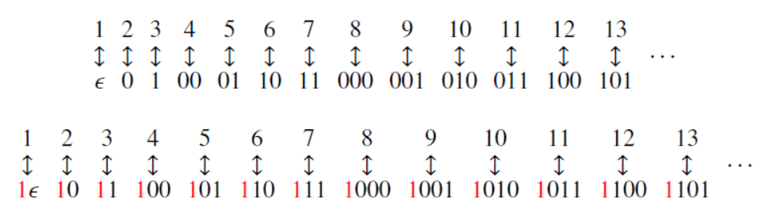

Enumerating binary strings
Every binary string can be enumerated with a sequence
The enumeration is done by the following approach
If a binary string $w$ is the $ith$ string, then $1w$ represents the binary integer $i$
The 5337th string is 010011011001,
since ${5337}_{2}$=1010011011001

Slide 58

Codes for Turing Machines
Enumerate every Turing machine by represent it with a binary string
So that every TM has a unique identification
Coding algorithm for $M=(Q,\left\{0,1\right\},Γ,δ,q_{1},B,\left\{q_{2}\right\})$
$Q=\{q_{1},q_{2},…,q_{k}\}$ with $q_{1}$ as start state and $q_{2}$ accepting state
$Γ=\{X_{1},X_{2},…,X_{m}\}$ with $X_{1}=0$, $X_{2}=1$ and $X_{3}=B$
$D_{1}=L, D_{2}=R$
Encode $δ$ function
for any $δ\left(q_{i},X_{j}\right)=(q_{k},X_{l},D_{m})$ for integers $i,j,k,l,m$
code the transition rule by the string $0^{i}{10}^{j}{10}^{k}{10}^{l}{10}^{m}$
The code for entire M is $C_{1}11C_{2}11…11C_{n−1}11C_{n}$ where $C_{i}$ is the code for a transition

Slide 59

Example
Let $M=(\left\{q_{1},q_{2},q_{3}\right\},\left\{0,1\right\},\left\{0,1,B\right\},δ,q_{1},B,\left\{q_{2}\right\})$
$δ\left(q_{1},1\right)=\left(q_{3},0,R\right), δ\left(q_{3},0\right)=\left(q_{1},1,R\right)$
$δ\left(q_{3},1\right)=\left(q_{2},0,R\right), δ\left(q_{3},B\right)=(q_{3},1,L)$
The codes for each rules are
0100100010100 0001010100100
00010010010100 0001000100010010
The code for M is
01001000101001100010101001001100010010010100 110001000100010010

Slide 60

Incompleteness
Not every binary string corresponds to a TM.
Example
any string that does not begin with 0
any string that has three or more consecutive 1
If a string $w_{i}$ (ith string in the enumeration) is not a TM code, we take $M_{i}$ to be the TM with $L\left(M_{i}\right)=∅$
We can construct a language and show that it is a Non-RE language

Slide 61

Diagonalization Language
The diagonalization language $L_{d}$ is the set of strings $w_{i}$ such that $w_{i}$ is not in $L(M_{i})$
$L_{d}$ consists of all strings $w$ that the TM $M$ whose code is $w$ does not accept input $w$
The table tells whether TM $M_{i}$ accepts input string $w_{j}$. The diagonal values tells whether $M_{i}$ accepts $w_{i}$

Slide 62

Diagonalization Language
There is no TM that accepts $L_{d}$.
Proof:
Suppose $L_{d}$ can be accepted by a TM $M$. Then there is a code for $M$, say $i$, $M=M_{i}$. Now check if $w_{i}∈L_{d}$
If $w_{i}∈L_{d}=L(M_{i})$, then $M_{i}$ accepts $w_{i}$. But by the definition of $L_{d}$, $w_{i}∉L_{d}$. Contradiction!
If $w_{i}∉L_{d}=L(M_{i})$, then $M_{i}$ does not accept $w_{i}$. But by the definition of $L_{d}$, $w_{i}∈L_{d}$. Contradiction!

Slide 63


Diagonalization Language
$L_{d}$ is not RE
$$L_{d}$$
RE
Recursive

Slide 64

Complements of Recursive Languages
Theorem: If $L$ is a recursive language, so is $\overline{L}$
The recursive language is closed under complementation
Proof:
Let $L=L(M)$, then construct a $M′$ as follows.
We have $L\left(M^{′}\right)=\overline{L}$

Slide 65

Complements
If a language $L$ is RE but $\overline{L}$ is not RE, then $L$ is not a recursive language
Proof:
Suppose $L$ is recursive, then $\overline{L}$ should also be recursive and thus a RE
But the hypothesis says $\overline{L}$ is not a RE. Contradiction!

Slide 66

Complement
Theorem: If both $L$ and $\overline{L}$ are RE, then $L$ must be recursive
Proof:
Let $M_{1}$ accepts $L$ and $M_{2}$ accept $\overline{L}$.

Slide 67

Proof
Make a two-tape TM $M$. One tape simulates the tape of $M_{1}$, the other simulates the tape of $M_{2}$. The state of $M$ is a composition of $(M_{1},M_{2})$
If $w∈L$, then $M_{1}$ will accept $w$ and $M$ will halt and accept $w$ too.
If $w∉L$, then $M_{2}$ will accept $w$ and $M$ will halt and reject $w$.
So $L$ is recursive

Slide 68

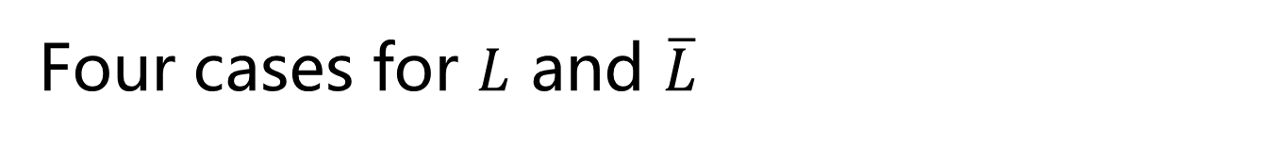


Four cases for $L$ and $\overline{L}$
Case 1: both $L$ and $\overline{L}$ are recursive
RE
Recursive
$$L$$
$$\overline{L}$$

Slide 69



Four cases for $L$ and $\overline{L}$
Case 2: Neither $L$ nor $\overline{L}$ is RE
$$L$$
RE
$$\overline{L}$$
Recursive

Slide 70



Four cases for $L$ and $\overline{L}$
Case 3: $L$ is RE but not recursive, and $\overline{L}$ is not RE
RE
$$\overline{L}$$
$$L$$
Recursive

Slide 71



Four cases for $L$ and $\overline{L}$
Case 4: $\overline{L}$ is RE but not recursive, and $L$ is not RE
RE
$$L$$
$$\overline{L}$$
Recursive

Slide 72



Example
$L_{d}$ is not RE, $\overline{L_{d}}$ is RE but not recursive
RE
$$L_{d}$$
$$\overline{L_{d}}$$
Recursive

Slide 73

Universal Language
The language $L_{u}$, the universal language, is the set of binary strings that encode a pair $(M,w)$
$M$ is a TM with the binary input
$w$ is a string in $\{0,1\}$
$w∈L(M)$
$(M,w)$ is of the form $C_{1}11C_{2}11…11C_{n}111w$
There is a TM $U$, called the universal Turing machine, such that $L_{u}=L(U)$

Slide 74


Universal language
$L_{u}$ is RE but not recursive
RE
Recursive
$$L_{u}$$

Slide 75

Other Undecidable Problems
If $w_{i}$ is a binary string, then it represents TM $M_{i}$
$L_{e}=\left\{w_{i} \right| L\left(M_{i}\right)=∅\}$
$L_{ne}=\left\{w_{i} \right| L\left(M_{i}\right)≠∅\}$
$L_{e}$ and $L_{ne}$ are complements of each other
$L_{ne}$ is RE but not recursive
$L_{e}$ is non-RE

Slide 76
Intractability
A problem is intractable if it can be solved but lack algorithm with polynomial time
Intractable problem is decidable
Intractable problem is hard to solve

Slide 77

Computation complexity
A Turing machine $M$ is of time complexity $T(n)$ if whenever $M$ is given an input $w$ of length $n$, $M$ halts after making at most $T(n)$ moves, regardless of whether it accepts or not
A language $L$ is in class P if there is some polynomial $T(n)$ such that $L=L(M)$ for some deterministic TM $M$ of time complexity $T(n)$
A language $L$ is in class NP if there is some polynomial $T(n)$ such that $L=L(M)$ for some nondeterministic TM $M$ of time complexity $T(n)$

Slide 78
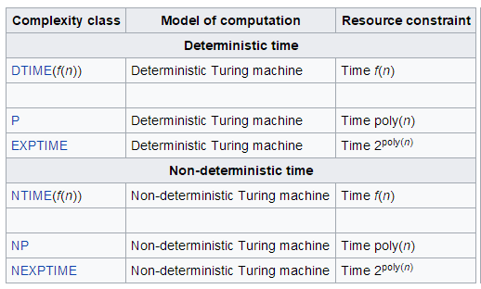
Computation complexity

Slide 79
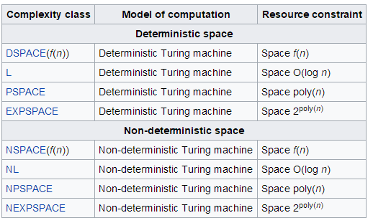
Computation complexity

Slide 80
Intractability
Intractable problems are those in EXPTIME, NP, NEXPTIME classes
However,
a problem is intractable does not imply that all large cases of the problem are hard or even that most of them are

Slide 81

P =? NP
It is trivial that $P⊆NP$
It appears that NP contains problems not in P
A NTM running in polynomial time has the ability to guess an exponential number of possible solutions to a problem and check each one in polynomial time, in parallel
However,
It has not been proved
It is one of the deepest open question

Slide 82
Example
The minimum spanning tree (MST)

Slide 83

Example: MST
Kruskal's algorithm $O(E∗log(V))$

Slide 84

Example: MST
Convert MST problem to a decision problem
Does graph $G$ have a MST of total weight $W$ or less
Conclusion:
The decision problem of MST is in P

Slide 85
Example
The traveling salesman problem (TSP):
Given a graph, find the minimum path starting and finishing at a specified vertex visiting each other vertex exactly once

Slide 86

Example: TSP
The most direct solution would be to try all permutations and see which one is minimum
The running time for this approach is $O(n!)$
Held–Karp algorithm is $O(n^{2}2^{n})$
On a multitape NTM, we can guess a permutation in $O(n^{2})$steps and check its total weight in a similar amount of time.
Conclusion: TSP problem is in NP

Slide 87

Reduction
To prove a new problem ($P_{2}$) is undecidable
Convert a known undecidable problem $P_{1}$ to $P_{2}$
Prove“if $P_{2}$ is decidable, then $P_{1}$ is decidable”

Slide 88

Reduction
To prove a new problem ($P_{2}$) is not in P
Choose a know problem $P_{1}$ that is not in P
Construct a reduction from $P_{1}$ to $P_{2}$
Prove“if $P_{2}$ is in P, then $P_{1}$ is in P”
Ensure that the construction of reduction should be polynomial-time complex

Slide 89

NP-Complete Problems
A problem $L$ is NP-complete if
$L$ is in NP
Every problem in NP is reducible to $L$ in polynomial time
Example
Hamilton-Circuit Problem
Boolean satisfiability Problem (SAT)
Three-Coloring Problem
Knapsack Problem

Slide 90

NP-Complete Problems
Theorem: If some NP-complete problem $L$ is in P, then P=NP
We believe strongly that none of the NP-complete problems are in P
no one has ever found a polynomial-time algorithm for any of the thousands of known NP-complete problems

Slide 91
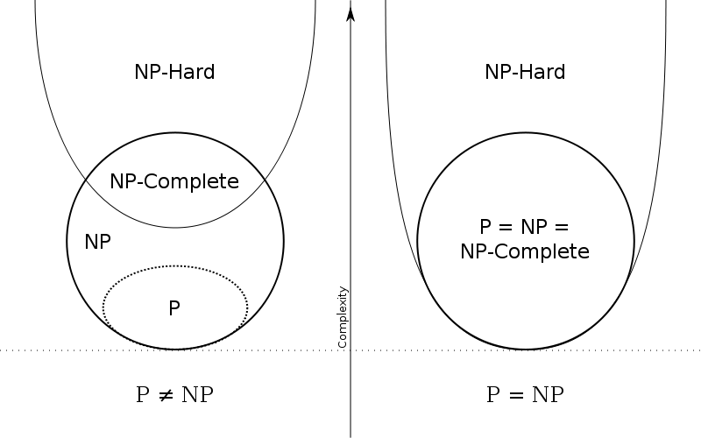
P, NP, NP-complete, NP-hard

